Slide 1
Team A
Project 6X6 Tic Tac Toe Game
By Ibra, Eddie, Jason, Carrie, Alexis, Alfonso

Slide 2
Introduction
Tic Tac Toe is a game that is played with two players, X and O, who take turns marking spaces usually in a 3X3 grid.
For this project the game will be change from its most common size 3x3 to a 6x6 with 4 squares require to win rather than 3.
In conclusion it will be 6X6X4 version of the classic Tic Tac Toe game.

Slide 3

Purpose of the Game
The purpose of the game is to win against an opponent.
To win, the player with most 4 square lined up wins:
Vertically
Horizontally
Diagonally
The winner will be determine once all spaces have been filled.
Have fun playing.
Notes:
GOALS: To play the game during downtime, to be entertained and to win the game.
TASKS:
<number>

Slide 4
How the game will work
At the start of the game, you will be given a login menu.
The user can either log in or register.
The user selects whether to compete against another user or the computer.
A player's statistics will be saved under their username.

Slide 5
New User Requirements
New User Requirements:
Register user.
Menu to choose PvP or PvE.

Slide 6
Existing User Requirements
Existing User Requirements:
Login and authentication.
Menu to choose PvP or PvE.
Notes:
GOALS: To play the game during downtime, to be entertained and to win the game.
TASKS:
<number>

Slide 7
Special case of Player vs Player
Player vs Player:
Log in and choose PvP.
Game starts as Player vs Player.
Update the score as squares connect.
Notes:
GOALS: To play the game during downtime, to be entertained and to win the game.
TASKS:
<number>

Slide 8
Special case of Player vs AI
Player vs AI:
Log in and choose PvE.
Game starts as Player vs AI.
Update the score as squares connect.

Slide 9
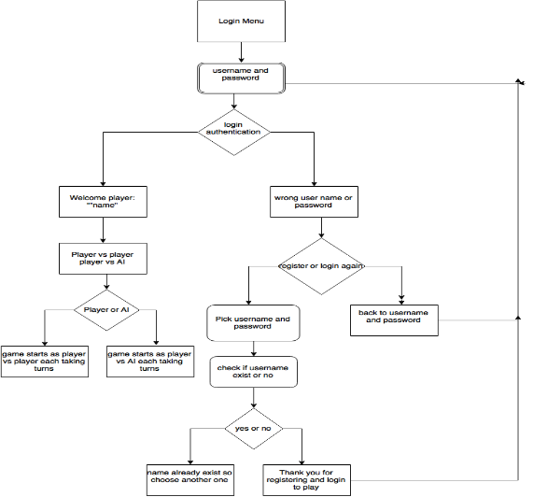
Game flow diagram

